Slide 1
ADVANCED DATA MANAGEMENT (CMM524)
Lecture 01 – Data Modelling

Slide 2
Content
The Database Revolutions
Structured vs Semi/unstructured data
Data Modelling

Slide 3
The 3 Database Revolutions
2003: MarkLogic
2004: MapReduce
2005: Hadoop
2005: Vertica
2007: Dynamo
2008 Cassandra
2008: Hbase
2008: NuoDB
2009: MongoDB
2010: VoltDB
2010: Hana
2011: Riak
2012: Areospike
2014: Splica Machine
1970: Codd’s paper
1974: System R
1978: Oracle
1980: commercial Ingres
1981: Informix
1984: DB2
1987: Sybase
1989: Postgres
1989: SQL server
1995: MySQL
1951: Magnetic tape
1955: Magnetic disk
1961: ISAM
1965: hierarchical model
1968: IMS
1969: Network model
1971: IDMS
1950-1972
pre-relational
1972-2005
relational
2005-2015
The next generation
Figure from G. Harrison, Next Generation Databases. Apress. 2015.

Slide 4
The Changing Needs
1st transition
start storing data in computers
2nd transition
relational databases make data more available to non-programmers
3rd transition
the bloom of the Internet means data volume has increased enormously
recognising the value of data (when you have a lot)
data structure is more loose

Slide 5
Structured vs Semi/Un-structured Data
Structured data
All instances follow the same (domain-dependent) structure
E.g. each student has a name, matriculation no., address
Each student studies multiple modules in a semester
Different instances may have different values
E.g. student/employee records, products in an online shop, customer orders
students may have different names, but they all have a name, a student number, DOB, etc.
semi/un-structured data
Not much structure
OR structure may change in different instances
E.g. web server access log, data from sensors, optional data fields

Slide 6
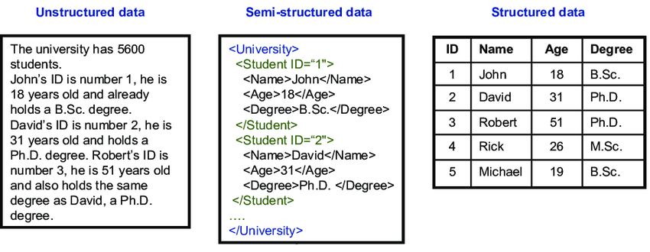
Unstructured, Semi-structured, & Structured Data Examples
Image source: https://www.researchgate.net/figure/Unstructured-semi-structured-and-structured-data_fig4_236860222

Slide 7
Managing Structured Data
Traditional databases require data to follow a pre-defined structure
structure must be defined before data are stored
called the database schema

Slide 8

Database Systems – 3-level Architecture
External level
(what end users see)
e.g. user account + order history
External view
External view
External view
Conceptual level
(how developers model/ understand a domain)
Conceptual schema
e.g. a user can relate to 0/more items via purchases
Internal schema
e.g. text/binary/indexed files
Internal level
(how data are actually stored in computers)

Slide 9
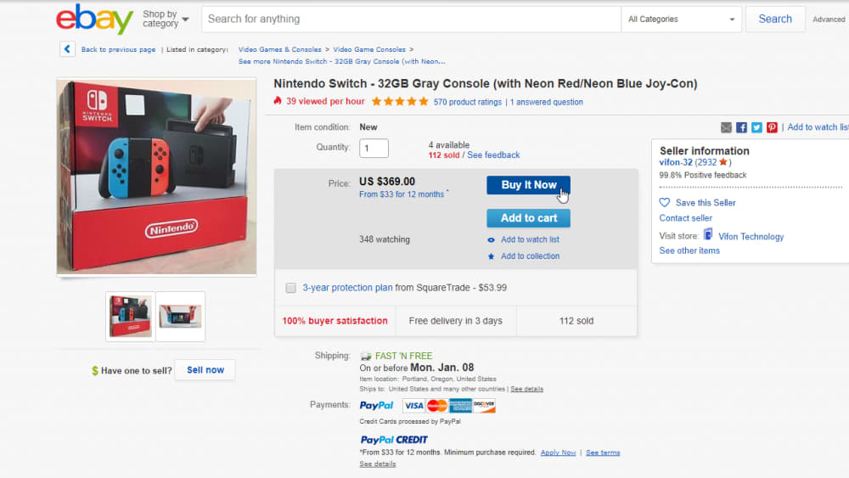
3-level Architecture (cont’d)
External (user logical, view) level
Closest to users’ understanding of the domain
Can hide parts of the database while exposing some
E.g. the list of items/bids you see in eBay

Slide 10
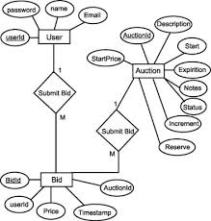
3-level Architecture (cont’d)
Conceptual (logical) level
Hides details of physical level
Focus on describing entities, relationships in domain
E.g. an item may have 0 or multiple bids in eBay
each seller may have 0 or more items for sale

Slide 11
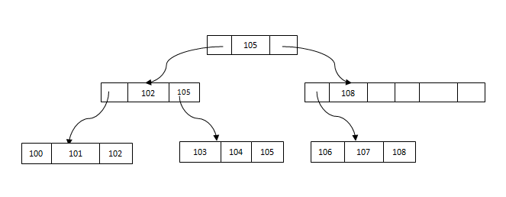
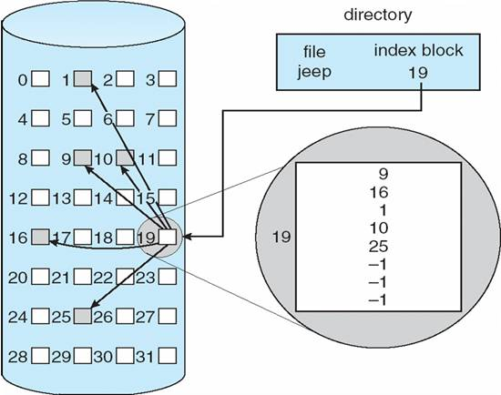
3-level Architecture (cont’d)
Internal (physical) level
Closest to physical storage, how data are physically stored
E.g. trees/ indexed files on hard disks

Slide 12
Data Modelling
Data model: a collection of concepts to describe the structure of a database
To manage data, we start by recognising “things of interest” in a domain
relevant information are captured
irrelevant details are discarded
Build a conceptual schema
Note: no need to worry about the internal schema as it is taken care of by the DBMS

Slide 13
Database, Schema & Data Instances
A schema describes the structure of a database
must be designed before database can be created
A schema does not change frequently
E.g. a student has a name which is a string, and a student number which is an integer, a student takes 1 or more modules
Data instances are actual data stored in the database
Data may change frequently
Data in a database at a particular moment of time is called a database state or snapshot

Slide 14
Major Phases in Database Creation
Requirement analysis
database requirements
key design process
Conceptual design
conceptual schema (e.g. ER model), data model independent
quite mechanical
Logical design
(data model mapping)
logical schema (e.g. tables), data model/ DBMS specific

Slide 15
Conceptual Data Modelling
Entity-Relationship modelling is a conceptual modelling method
Analyse data requirements to identify:
Entities
A distinguishable object in the domain
E.g. an employee, a student, a car, an order/purchase
Attributes/properties
A piece of information that describes an entity
E.g. the name of an employee, the date of a purchase
Relationships
Connects 2 or more entities
E.g. a customer ordered an item
May have properties
E.g. a book is borrowed by a library user on a certain date, with due date
Constraints/restrictions
An ER model is independent of its implementation.

Slide 16
Entity-Relationship Modelling – Entities
Basic objects in an ER model
Models a physical object or conceptual existence
You need to identify objects of interest that you want to keep/store
employee
department
Entities in a human resource domain.
supplier
company
part
Entities in a supplier domain.

Slide 17
ER Modelling – Attributes
An attribute describes an entity or relationship
detail of an entity
Your need to identify properties of interest on an entity
A key attribute uniquely identifies an instance of the entity/relationship
Key attribute is underlined in an ER diagram
you can have a composite key that combines multiple attributes
gender
address
name
salary
employeeID
employee
dateOfBirth

Slide 18
Artificial Key in Entity
a “make-up” attribute that uniquely identify an instance of an entity
has no meaning to the business/organisation
permitted when:
no attribute has all primary key properties
OR primary key is large/complex
simply speaking: artificial key is for convenience
as a general rule: if you don’t really need it, don’t use it

Slide 19
Artificial Key Example
address
address
vs
password
user
email
password
user
email
name
name
userNo
if you don’t allow 2 users to have the same email address, then email is unique
but what if a user wants to change his/her email?

Slide 20
ER Modelling - Relationship
A relationship is an association among entities
May relate 2 or more entities
You need to identify relationships of interest linking entities
worksFor
employee
department
supervisor
supervisee
manages
supervise

Slide 21
Degree of Relationship
The number of entity types participating in the relationship
Binary: 2 parties
Ternary: 3 parties
N-ary: n parties
employee
worksFor
department
Binary:
supplier
supplies
product
ternary:
company

Slide 22
Multiplicity: 1-to-1 Relationship
1 instance of an entity relates to exactly 1 instance of another entity
employee
department
1
0..1
manages
An employee manages 0 or 1 department
A department is managed by exactly 1 employee.

Slide 23
Multiplicity: 1-to-Many Relationship
1 instance of an entity can relate to multiple instances of another instance
An employee works for exactly 1 department.
A department may have 1 or more employees working for it.
worksFor
1..*
1
1
employee
department
0..*
supervisor
supervise
supervisee
An employee supervises 0 or more (other) employee(s).
An employee is supervised by exactly 1 (other) employee.

Slide 24
Multiplicity: Many-to-many Relationship
Many instances of an entity can relate to many instances of another entity
buys
0..*
0..*
customer
product
A customer buys 0 or many products.
A product is bought by 0 or many customers.

Slide 25
Relationship with Attribute(s)
The attribute value is attached to an instance of the relationship
E.g. even the same customer buying the same product again may have a different purchase price
purchasePrice
customer
0..*
buys
product
0..*
borrows
0..*
book
user
0..*
borrowDate
dueDate

Slide 26
The Conceptual Model
an ER model is only a conceptual model
is the easiest way to understand the domain data structure
it DOES NOT tell you how to implement it
To implement a given conceptual model as a database, you need to choose a data model
E.g. the relational data model uses relations to implement a conceptual model
the functional data model uses functions
The object data model uses objects
The hierarchy data model uses hierarchies (i.e. trees)
then map your conceptual model into a schema (specific to a data model)
We will look at the RDM as it is the most common one.

Slide 27

The Relational Data Model (RDM)
Model data as relations
Don’t confuse with relationships in ER modelling
Can be used to implement an ER model
A database contains tables (relations)
A table has columns/fields (i.e. attributes)
Defined by database schema
A row (i.e. record) is an instance of an entity
in RDM, a database schema is a set of table structures
user
book
borrows

Slide 28
Tables, Columns & Rows
employeeID | name | gender | DOB | address | salary
1 | Peter Parker | M | ... | … | …
2 | Tony Stark | M | … | … | …
3 | Diana Prince | F | … | … | …
4 | Steve Rogers | M | … | … | …
5 | Motoko Kusanagi | F | … | … | …
A row
Each row is an instance of the Employee entity.
A column

Slide 29
ER to Relation Mapping - Entity
For each entity in the ER model:
defines a table
Each attribute becomes a column in the table
Key attribute becomes key of the table
name
gender
address
employeeID
employee
dateOfBirth
salary

Slide 30
Entity to Table Mapping Example
employeeID | name | gender | DOB | address | salary
1 | Peter Parker | M | … | … | …
2 | Tony Stark | M | … | … | …
3 | Diana Prince | F | … | … | …
4 | Steve Rogers | M | … | … | …
5 | Motoko Kusanagi | F | … | … | …

Slide 31
ER to Relation Mapping – Binary 1-to-1 Relationship
For a 1-to-1 relationship between entity₁ and entity₂ which are mapped into tables T₁ and T₂:
Add a foreign key of T₁ into T₂
OR a foreign key of T₂ into T₁
employee
department
1
0..1
manages

Slide 32
1-to-1 Relationship to Table Mapping Example
employee
department
employeeID | name | manages | …
1 | P. Parker | 200
2 | T. Stark | null
3 | D. Prince | 100
4 | S. Rogers | null
5 | M. Kusanagi | 300
deptCode | name
100 | sales
200 | marketing
300 | accounting
Foreign key to department

Slide 33
1-to-1 Relationship – Alternative Mapping
department
employee
employeeID | name | …
1 | P. Parker
2 | T. Stark
3 | D. Prince
4 | S. Rogers
5 | M. Kusanagi
deptCode | name | manageBy
100 | sales | 3
200 | marketing | 1
300 | accounting | 5
Foreign key to employee

Slide 34
No Foreign Keys in ER Model
foreign key is the mechanism in the Relational Data Model to implement relationships in a data model
an ER model NEVER has any foreign key!!!
foreign keys only appear when a conceptual model (i.e. ER) is mapped into tables
i.e. implemented using a relational database

Slide 35
ERROR: Foreign Key in ER Model
name
manageBy
employeeID
employee
deptCode
department
name
1
0..1
manages
at this stage, you DO NOT worry about how to implement the relationship
you may not even have a table (if you are not using RDBMS)

Slide 36
ER to Relation Mapping – Binary 1-to-many Relationship
For a 1-to-many relationship between entity₁ & entity₂ mapped into tables T₁ & T₂:
Add the foreign key of T₁ into T₂
i.e. foreign key goes to the ”many” side of relationship
1..*
workFor
1
employee
department

Slide 37
1-to-many Relationship Mapping Example
employee
department
employeeID | name | manages | worksFor
1 | P. Parker | 200 | 200
2 | T. Stark | null | 300
3 | D. Prince | 100 | 100
4 | S. Rogers | null | 100
5 | M. Kusanagi | 300 | 300
deptCode | name
100 | sales
200 | marketing
300 | accounting
Foreign key to department

Slide 38
ER to Relation Mapping – Binary Many-to-many Relationship
For a many-to-many relationship between entity₁ & entity₂
Assuming entity₁ & entity₂ are mapped in table T₁ & T₂, with keys K₁ & K₂ respectively
Create a new table R to implement the relationship
Add foreign keys of both T₁ & T₂ into R
R has the composite key of (K₁,K₂)
buys
0..*
0..*
customer
product

Slide 39
Many-to-many Relationship
product
customer
productID | description | currentPrice
1001 | iPhone X | 999
1002 | Galaxy S8 | 689
1003 | Pixel | 509
1004 | Kindle Fire | 79.99
1005 | iPad Air | 469
customerID | name | …
1 | C. Kent | …
2 | B. Wayne | …
3 | D. Trump | …
4 | … | …
5 | … | …
customerID | productID
3 | 1001
2 | 1001
3 | 1004
1 | 1004
2 | 1005
Note: You can’t have the same customer buying the same product multiple times in this design. You’ll need a “purchase date” or “order ID” to do it. This can be recognised in the ER designing stage.
Composite key
buys

Slide 40
ER to Relation Mapping – N-ary Relationship
For a n-ary relationship among entity₁, entity₂, … entity_{n}
Assuming entity₁, …, entity_{n} are mapped into tables T₁, …, T_{n} with keys K₁, …, K_{n}
Create a new table R
Include in R the foreign keys of T₁, T₂, …, T_{n}
Key of R is the composite key (K₁, …, K_{n})
supplies
supplier
product
company

Slide 41
N-ary Relationship to Table
company
supplier
companyID | name | …
C1 | Microsoft | …
C2 | Apple | …
C3 | Google | …
supplierID | name | …
S1001 | Amazon | …
S1002 | Andrex | …
S1003 | Samsung | …
Composite key
supplies
product
companyID | supplierID | partsNo
C3 | S1001 | PN600
C3 | S1001 | PN700
C2 | S1001 | PN700
C1 | S1002 | PN500
C3 | S1002 | PN500
productID | description | …
PN500 | Andrex rolls x6 | …
PN600 | Paper cups x100 | …
PN700 | Nescafe Gold 250g | …

Slide 42
Relationship with Attribute(s) Mapping
For each relationship R with attribute(s):
Create an entity with attribute(s)
Then map entity to table
Table will have foreign keys of all entities involved in R
purchasePrice
customer
0..*
buys
product
0..*

Slide 43
Relationship with Attribute to Table
product
customer
productID | description | currentPrice
1001 | iPhone X | 999
1002 | Galaxy S8 | 689
1003 | Pixel | 509
1004 | Kindle Fire | 79.99
1005 | iPad Air | 469
customerID | name | …
1 | C. Kent | …
2 | B. Wayne | …
3 | D. Trump | …
4 | … | …
5 | … | …
customerID | productID | purchasePrice
3 | 1001 | 1100
2 | 1001 | 979
3 | 1004 | 99.99
1 | 1004 | 99.99
2 | 1005 | 529.99
Composite key
buys

Slide 44
Database Normalisation
the process of efficiently organising data in a database:
avoid redundancy
which may lead to inconsistency
improve data integrity
result in a good database structure
to be discussed in a later lecture

Slide 45
Database Design & Creation – A Summary
Create ER model
Map ER to RDM
normalisation
Always start by designing an ER model
ER is a conceptual model
Independent of implementation
can be implemented in different data models
allows you to see if all required information are captured correctly
NEVER start your design from tables

Slide 46
Conclusions
Relational data model is the most popular one for structured data
Start with conceptual data modelling (ER model)
Map conceptual model to logical model (tables)

